Slide 1

Machine Learning
- Model Optimization
& Model Compression -
Session 4:
October 28th
13:00 – 14:00
ITU AI/ML in 5G Challenge

Slide 2
Previous Mentoring Sessions
9/6 Computer Networks Introduction
https://www.youtube.com/watch?v=4XIbmOqx9ak&list=PLQqkkIwS_4kXzAb8yohjHlMVrIx8GNazO&index=2
9/15 Data Preprocessing
https://www.youtube.com/watch?v=CdLQEeLyWzI&list=PLQqkkIwS_4kXzAb8yohjHlMVrIx8GNazO&index=1
9/29 Model Building and Training
https://www.youtube.com/watch?v=7uAp7kGquA&list=PLQqkkIwS_4kXzAb8yohjHlMVrIx8GNazO&index=1
This week’s mentoring session recording will be released on the neural network and on youtube soon.
You can find all resources from the previous mentoring sessions here: https://github.com/ITU-AI-ML-in-5G-Challenge/MentoringSessions2022

Slide 3
Table of Contents
Model Optimization
Model Compression
Jupyter Notebooks (Hands on)
Q&A session

Slide 4







Machine Learning Steps
Last Session
Collect data
Data
Preprocessing
Model
Training
Evaluation
Deployment
This Session
Compression
Collect data
Data
Preprocessing
Model
Training
Optimization
Deployment

Slide 5
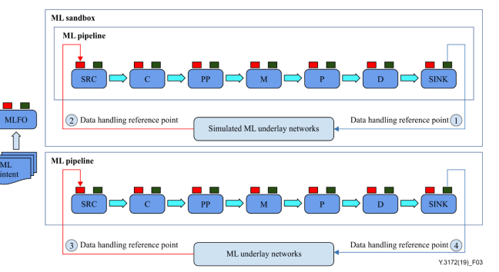
Machine Learning Steps
C : Collector
PP: Pre-processor
M : Model
P : Policy
D : Distributor
SRC: Source of data
SINK: Target of ML output

Slide 6

Model Optimization

Slide 7
Model Optimization
What is model optimization?
Optimization is the process where we train the model iteratively so as improve the accuracy of the machine learning model.
This process can be performed by using optimisation algorithms.
Examples of Optimization Algorithms:
Gradient Descent
(For deep learning especially) stochastic gradient descent with momentum, RMSProp and Adam Optimizer

Slide 8
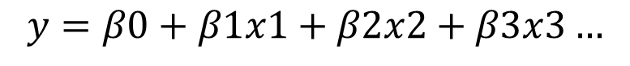
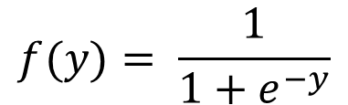
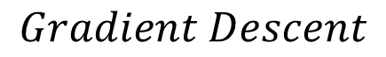
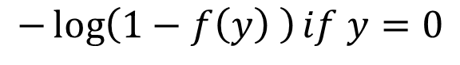

Model Optimization
Logistic Regression
We set up a function that takes weights β, inputs x and produces predictions y.
(The prediction y is put through the sigmoid function)
The error function then takes the predictions and compares them to the true results
The error is sent to the optimizer to calculate the new set of weights in the original function
$$y=β0+β1x1+β2x2+β3x3…$$
Sigmoid Function
$$f(y)= \frac{1}{1+e^{−y}}$$
Error (Cost Function)
Optimizer
$$− log(f\left(y\right)) if y=1$$
$$Gradient Descent$$
$$−\log\left(1−f\left(y\right) \right)if y=0$$

Slide 9
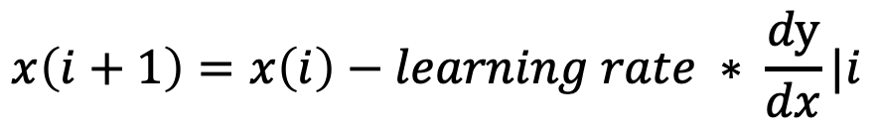
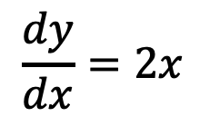
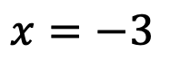
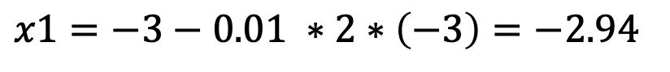
Gradient Descent
We start from a random point:
$$x=−3$$
$$\frac{dy}{dx}=2x$$
Calculate the gradient of this function:
Leaning Rate = 0.01
Iterations:
$$x\left(i+1\right)=x\left(i\right)−learning rate ∗ \frac{dy}{dx}|i$$
1st Iteration:
$$x1=−3−0.01 ∗2∗\left(−3\right)=−2.94$$

Slide 10
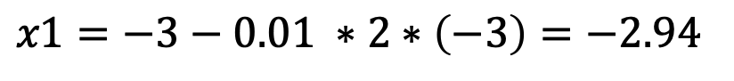
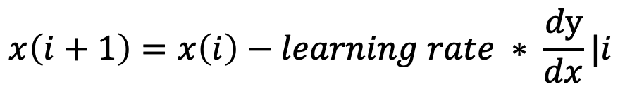
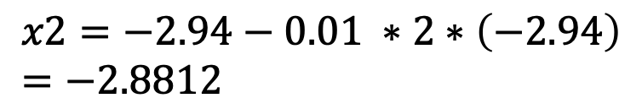
Gradient Descent
Iterations:
$$x\left(i+1\right)=x\left(i\right)−learning rate ∗ \frac{dy}{dx}|i$$
1st Iteration:
$$x1=−3−0.01 ∗2∗\left(−3\right)=−2.94$$
2nd Iteration:
$$x2=−2.94−0.01 ∗2∗\left(−2.94\right)=−2.8812$$
We continue to do this until we reach a global or local minimum
With a large dataset, this calculation takes a lot of time. So, we can use other things such as stochastic gradient descent.

Slide 11
Hyperparameter
Tuning

Slide 12
Hyperparameter Tuning
Hyperparameters are classified as…
model hyperparameters: influence the performance of the model
algorithm hyperparameters: affect the speed and quality of the learning process. ie. Batch size, epochs, learning rate
Examples:
Train-test split ratio (80-20 / 70-30)
Learning rate in optimization algorithms (e.g. gradient descent)
Choice of activation function (e.g. Sigmoid, ReLU, Tanh)
The choice of cost or loss function the model will use
Number of hidden layers in a neural network
→ Depends on the choice of your machine learning algorithm

Slide 13
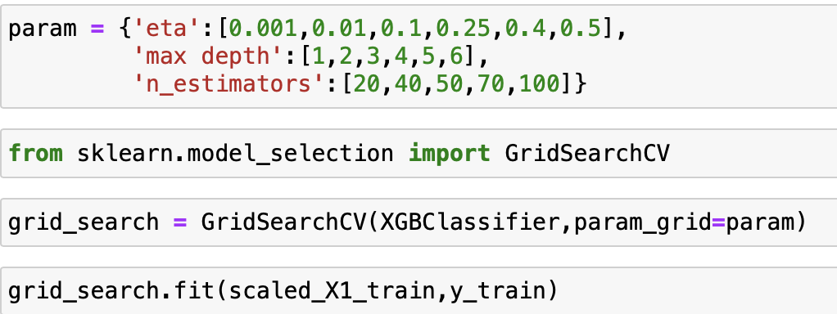
Grid Search ie. XGBoost
General Parameters:
Booster: gbtree, dart, or gblinear
Eta: similar to learning rates in gradient descent (usually between 0 and 1)
Max Depth: The maximum depth of a tree (usually between 3 - 10)
N_Estimators: The number of trees you want to build before taking the maximum voting or averages of predictions.
→ How do we know what works best for our model?
→ GridsearchCV

Slide 14
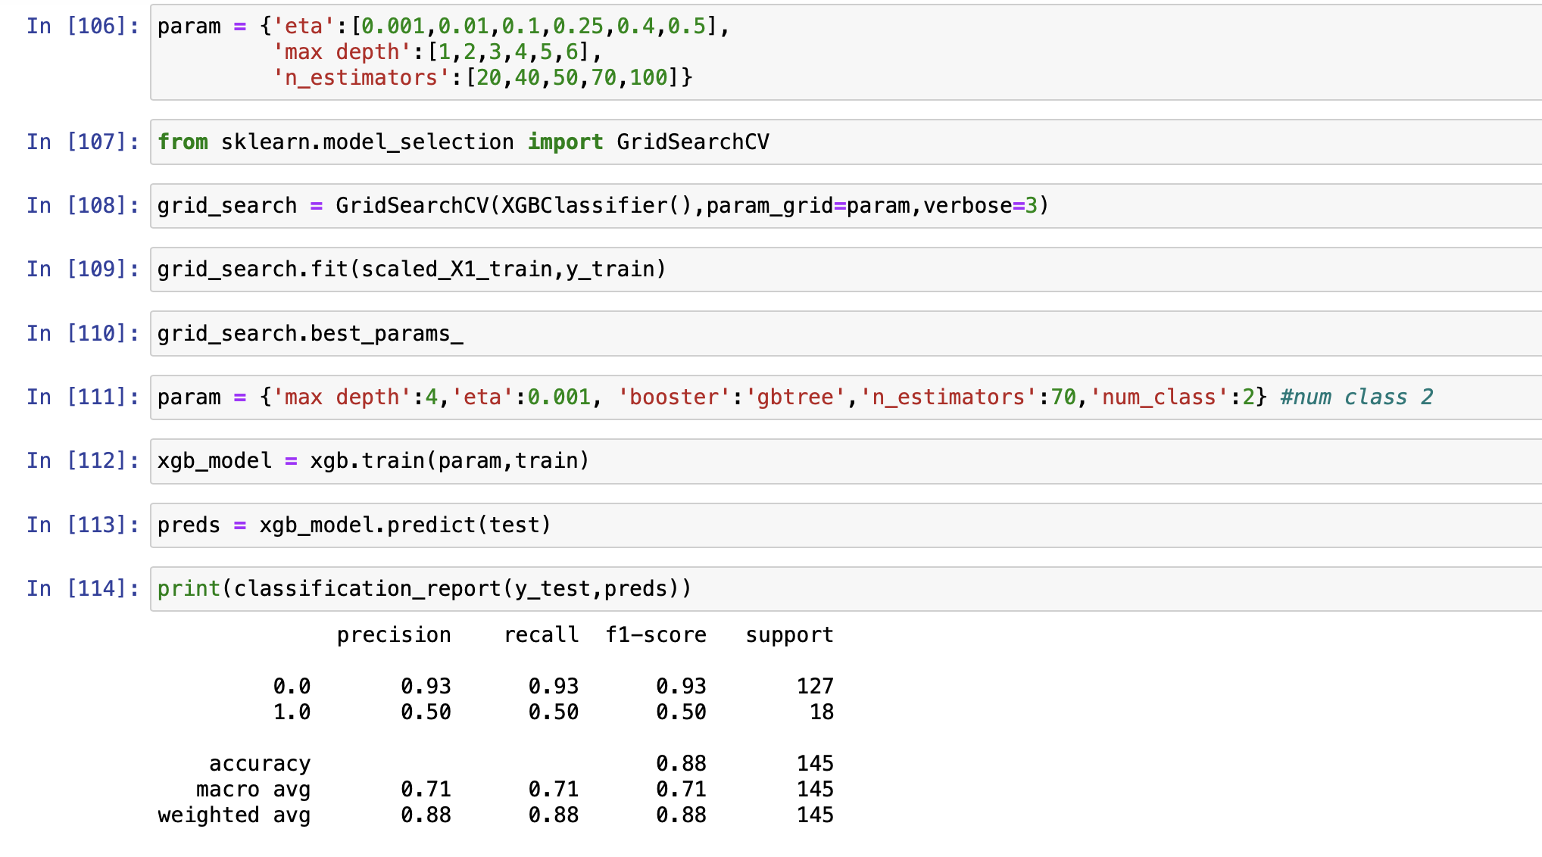

Slide 15
Model
Compression

Slide 16

Why do we need to compress our models?
Speed
Accuracy
Size
There are many reasons why you may need to compress your model…
For example:
Today, many real-world applications demand real-time, on-device processing capabilities, meaning that AI technology must work on edge devices.
Unfortunately, edge devices are resource-constrained.
The models that are big in size are expected to perform well, but evidently, the bigger the model, the more storage space it needs.
→ We have to reduce the size of the model (trade off with accuracy)
Trade Off

Slide 17
Model Compression Techniques
Quantization
Knowledge distillation
Low-rank factorization
Pruning

Slide 18

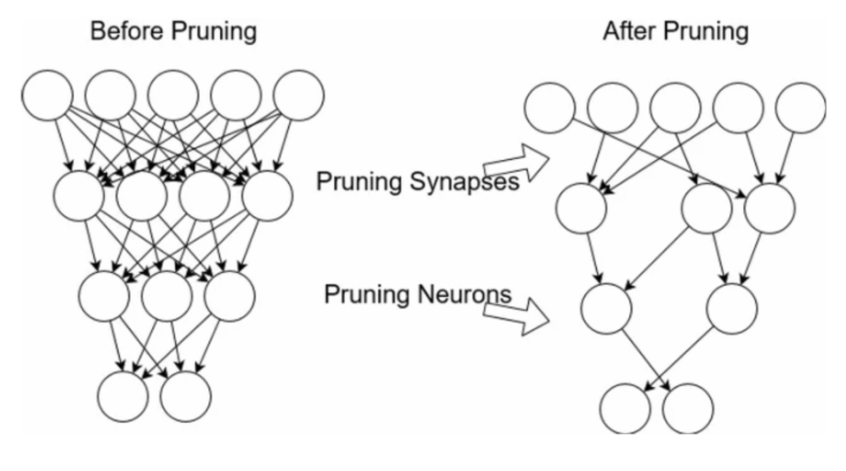
Pruning
Pruning is the process of removing weight connections in a neural network
= increases inference speed & decreases model memory size
Pruning can also be used with decision trees to reduce its size.
Image from: L2 Norm: Pokhrel, Sabina. 4 Popular Model Compression Techniques Explained. xailient.com/blog/4-popular-model-compression-techniques-explained. Accessed 26 Oct. 2022.

Slide 19
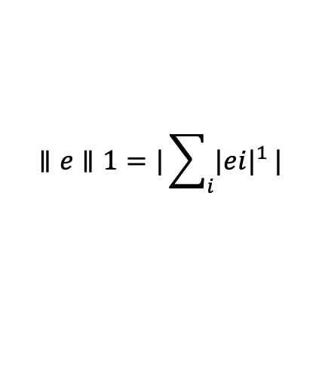
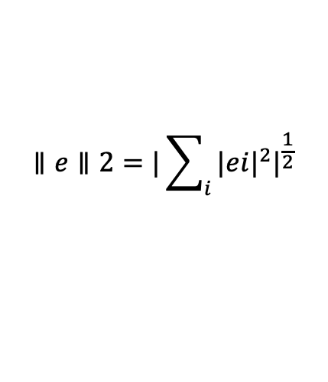
Pruning Technique
Weight Pruning
Weight connections that are below a certain, pre-defined threshold is zeroed out
Neuron Pruning
Instead of the weights, the neurons are pruned
Filter Pruning
First, the importance of the filters are calculated by the L1, L2 norm and these filters are ranked according to this value. With filter pruning, we prune out filters that have lower ranking values.
Layer Pruning
The layers are pruned.
L1 Norm:
$$∥e∥1=|\sum_{i}{{|ei|}^{1}}|$$
L2 Norm:
$$∥e∥2=|\sum_{i}{{|ei|}^{2}|^{\frac{1}{2}}}$$
L2 Norm: Pokhrel, Sabina. 4 Popular Model Compression Techniques Explained. xailient.com/blog/4-popular-model-compression-techniques-explained. Accessed 26 Oct. 2022.

Slide 20
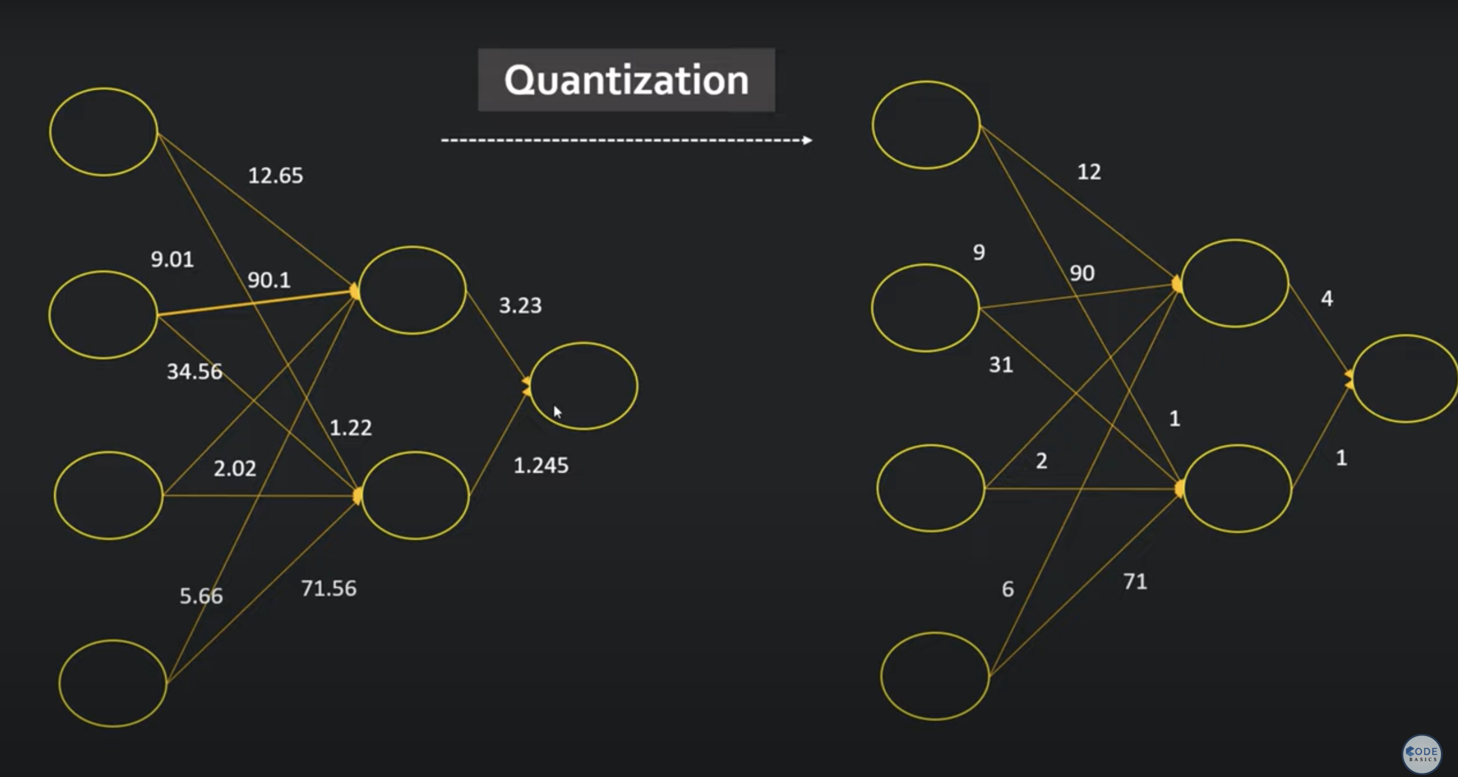
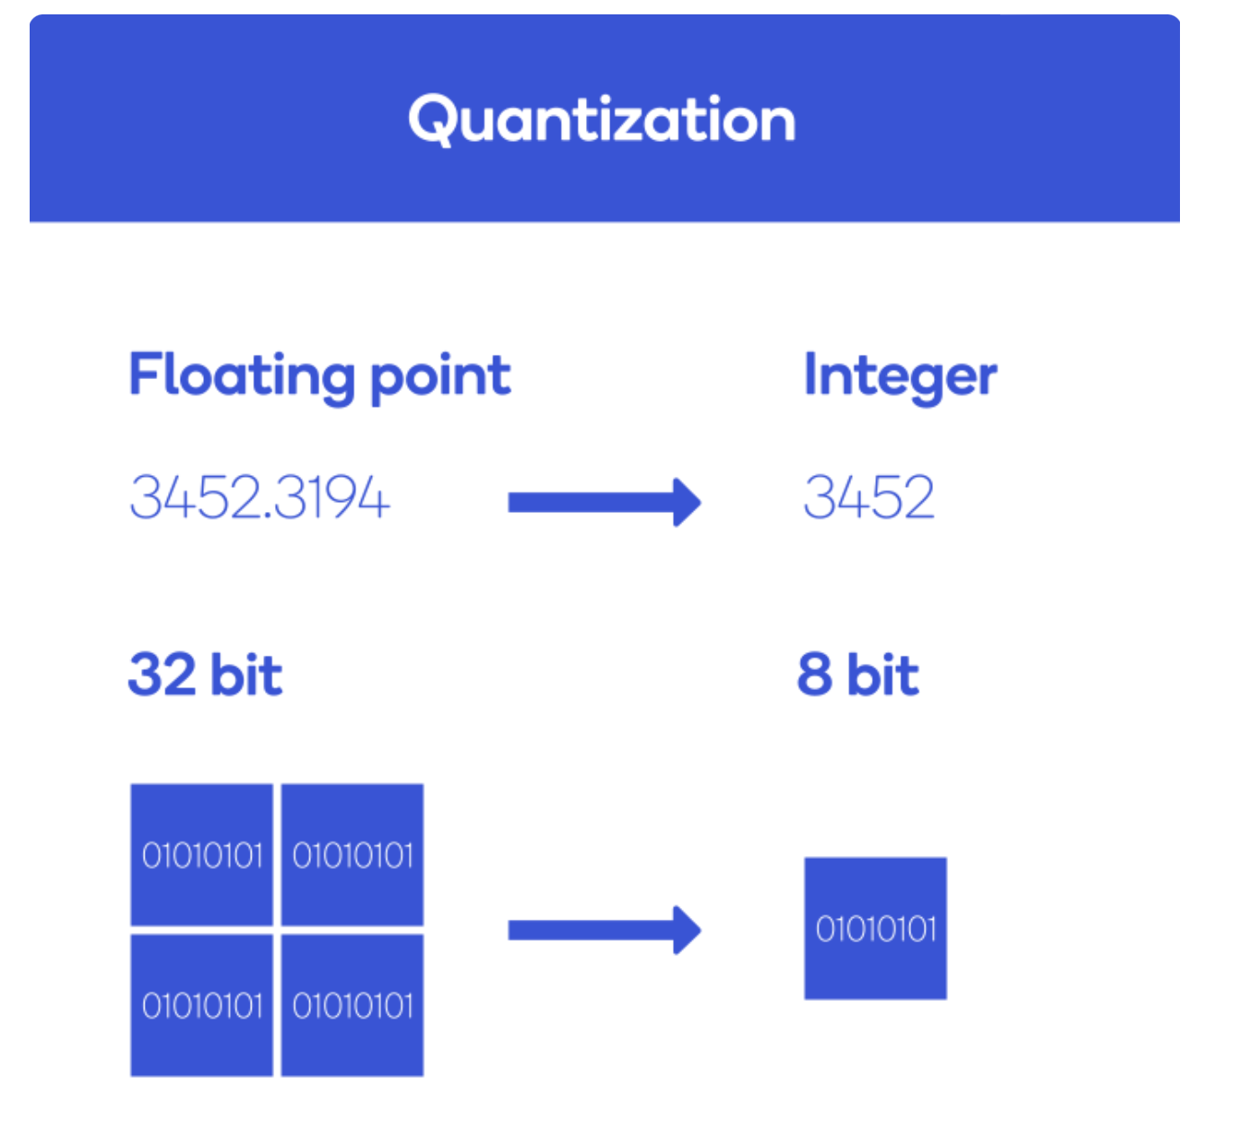
Quantization
Quantization is the process of converting data in floating point 32 bits to a smaller precision such as integer 8 bit, whilst still maintaining the original accuracy of the model.
Image from:
Left – Here’s Why Quantization Matters for AI. www.qualcomm.com/news/onq/2019/03/heres-why-quantization-matters-ai. Accessed 26 Oct. 2022.
Right – codebasics. “Quantization in Deep Learning | Deep Learning Tutorial 49 (Tensorflow, Keras and Python).” YouTube, 14 Aug. 2021, www.youtube.com/watch?v=v1oHf1KV6kM.
Notes:
https://www.qualcomm.com/news/onq/2019/03/heres-why-quantization-matters-ai
Precision is the number of digits in a number. Scale is the number of digits to the right of the decimal point in a number. For example, the number 123.45 has a precision of 5 and a scale of 2.
Weights are float 32
https://www.youtube.com/watch?v=v1oHf1KV6kM

Slide 21
Previous Problem Statements
ITU-ML5G-PS-007: Lightning-Fast Modulation Classification with Hardware-Efficient Neural Networks
“In this challenge, the participants will design neural networks with an awareness of both inference computation cost and accuracy to explore the landscape of compact models for RF modulation classification on the DeepSig RadioML 2018 dataset.”
“The goal is to use quantization, sparsity, custom topology design and other training techniques to design a neural network that achieves a certain minimum accuracy.”
From: ITU AI Challenge. challenge.aiforgood.itu.int/match/matchitem/34. Accessed 26 Oct. 2022.
Other problem statements:
DNN Inference Optimization
Multi-Context based Knowledge Distillation

Slide 22
References
Previous mentoring sessions:
9/6 Computer Networks Introduction
https://www.youtube.com/watch?v=4XIbmOqx9ak
9/15 Data Preprocessing
https://www.youtube.com/watch?v=CdLQEeLyWzI&list=PLQqkkIwS_4kXzAb8yohjHlMVrIx8GNazO&index=2
9/29 Model Building and Training
https://www.youtube.com/watch?v=7uAp7kGquA&list=PLQqkkIwS_4kXzAb8yohjHlMVrIx8GNazO&index=1
All resources: https://github.com/ITU-AI-ML-in-5G-Challenge/MentoringSessions2022
Recommendation ITU-T Y.3172
Another tutorial you may want to take a look at: “Quantization in Deep Learning | Deep Learning Tutorial 49 (Tensorflow, Keras and Python).” YouTube, 14 Aug. 2021, www.youtube.com/watch?v=v1oHf1KV6kM.

Slide 23
Jupyter Notebook
Practice

Slide 24
Q & A

